Slide 1
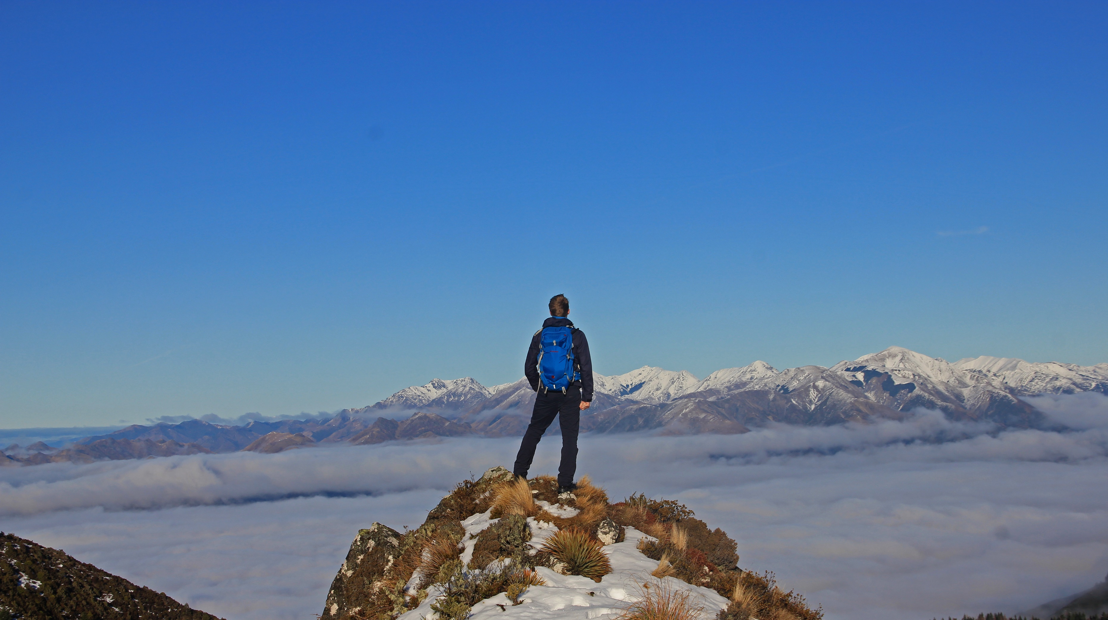
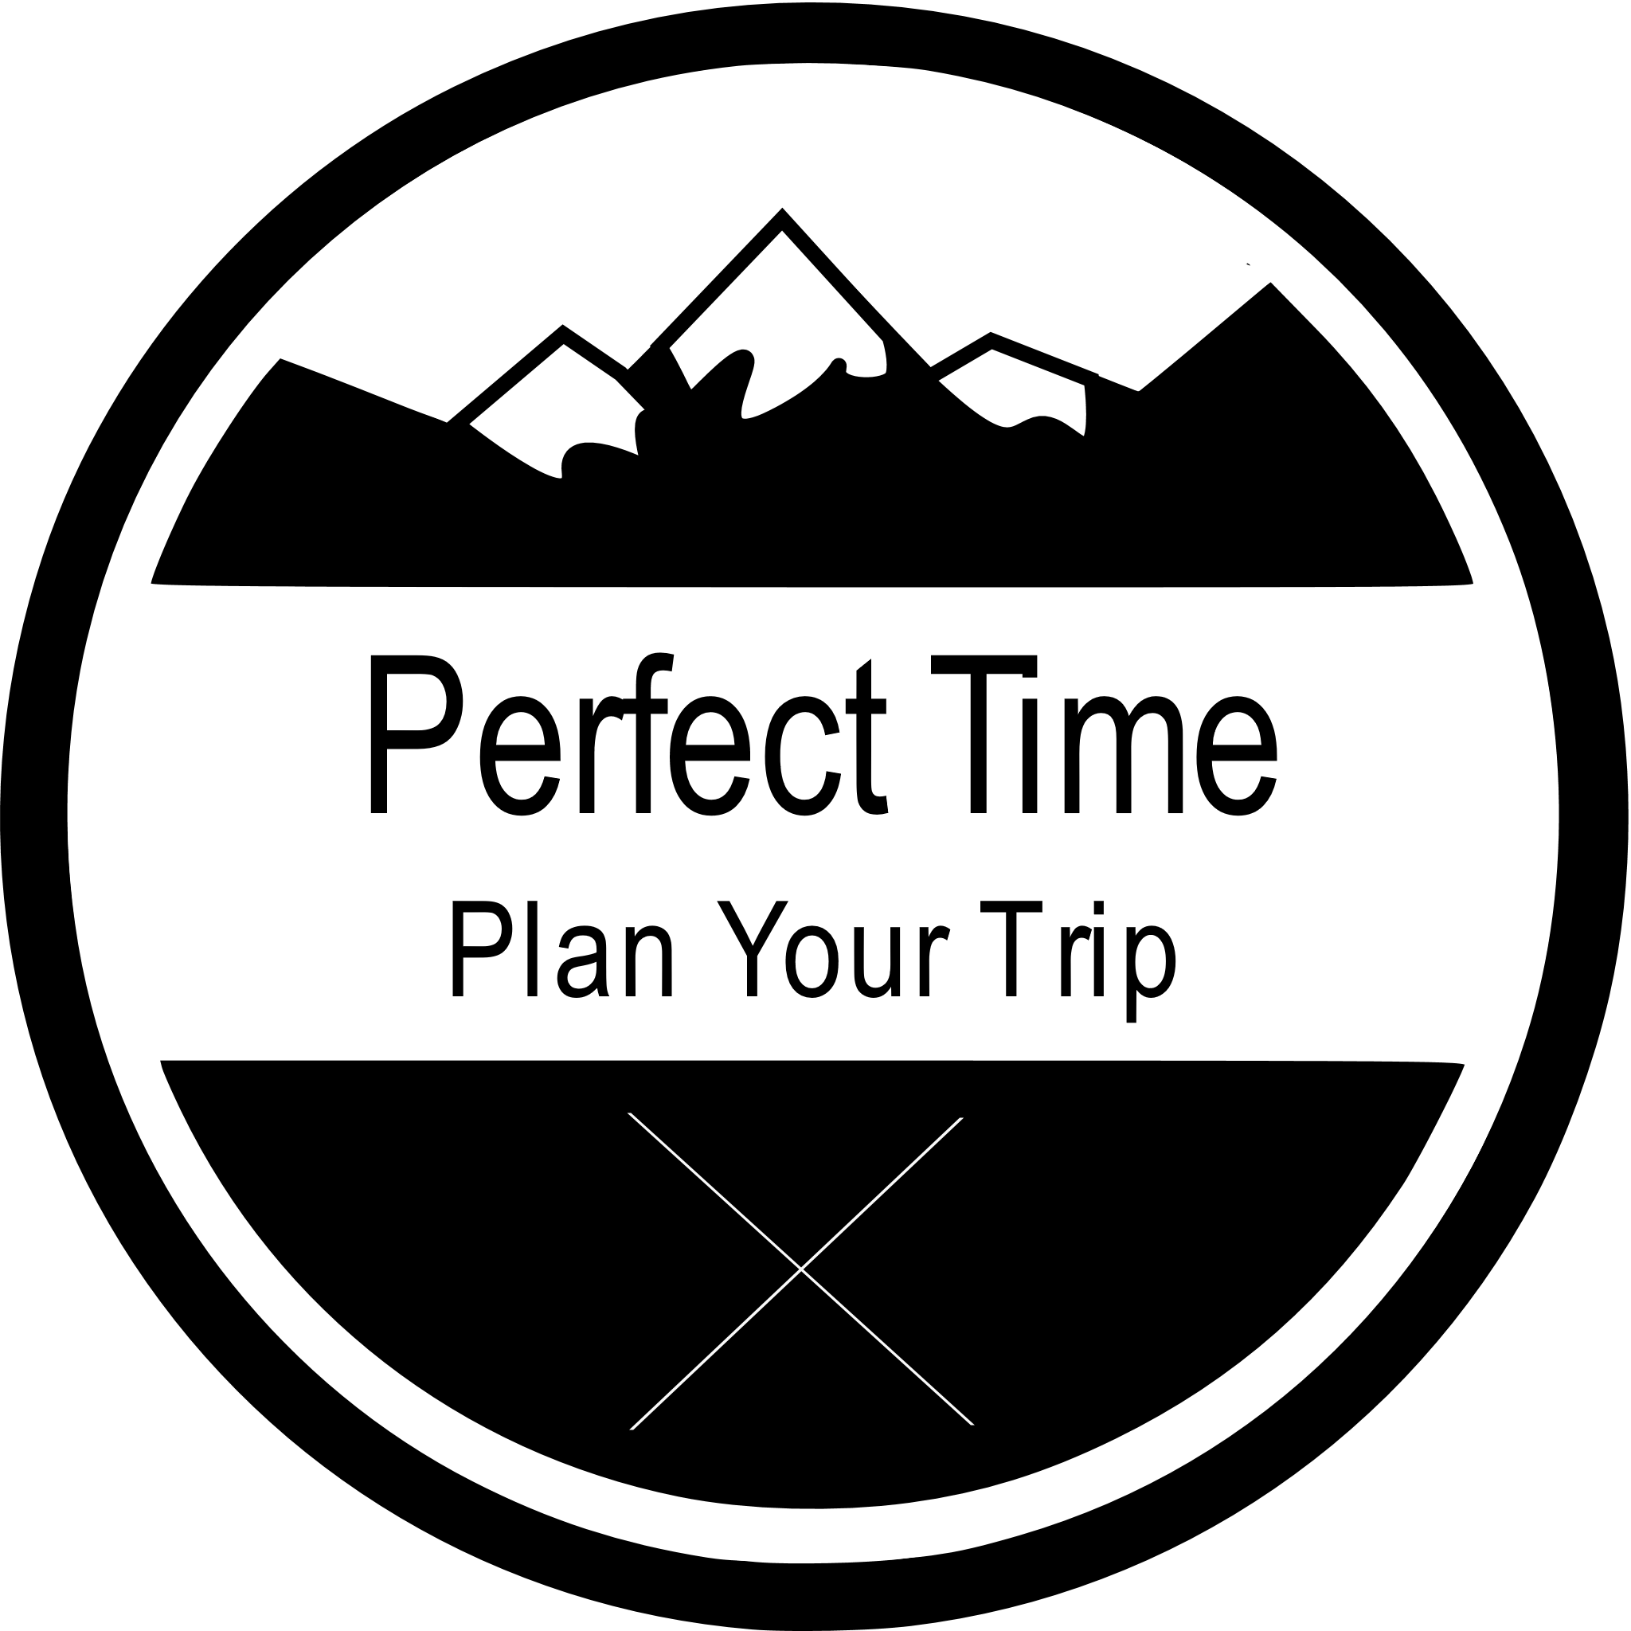
Conquer the world.
Plan your campaign today.

Slide 2
Are you ready for (a) Perfect Time?
Perfect Time – Plan Your Trip
The planning tool for your perfect vacation

Slide 3
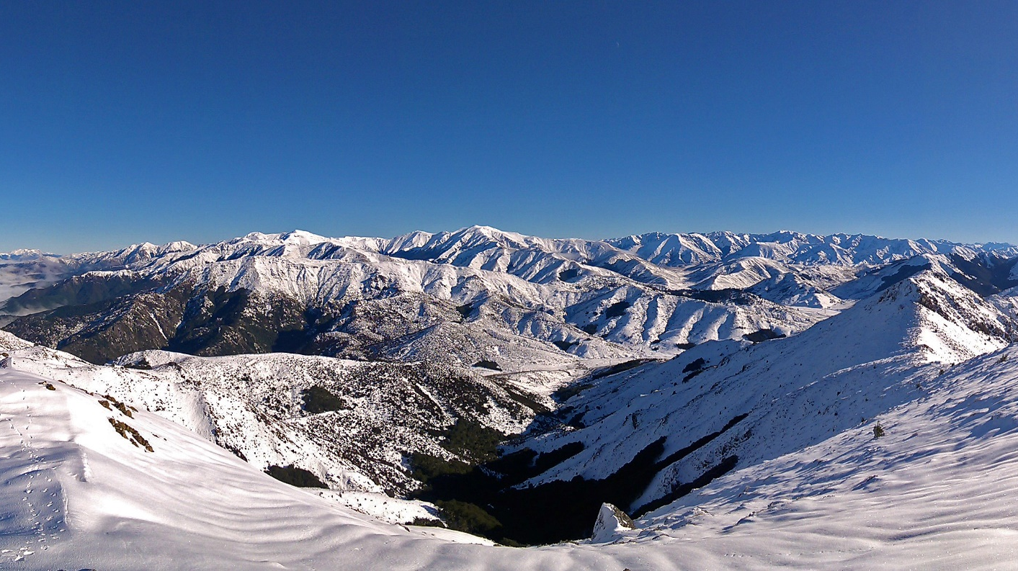
Stand on top of the world.
Plan your hike today.

Slide 4
What to expect?
What is Perfect Time?
Why would you use Perfect Time?
What is the foundation of Perfect Time?
How was Perfect Time designed?
Who is creating Perfect Time? How does the team organize itself?
How is quality promoted and enforced?
What is the current state of the project?

Slide 5
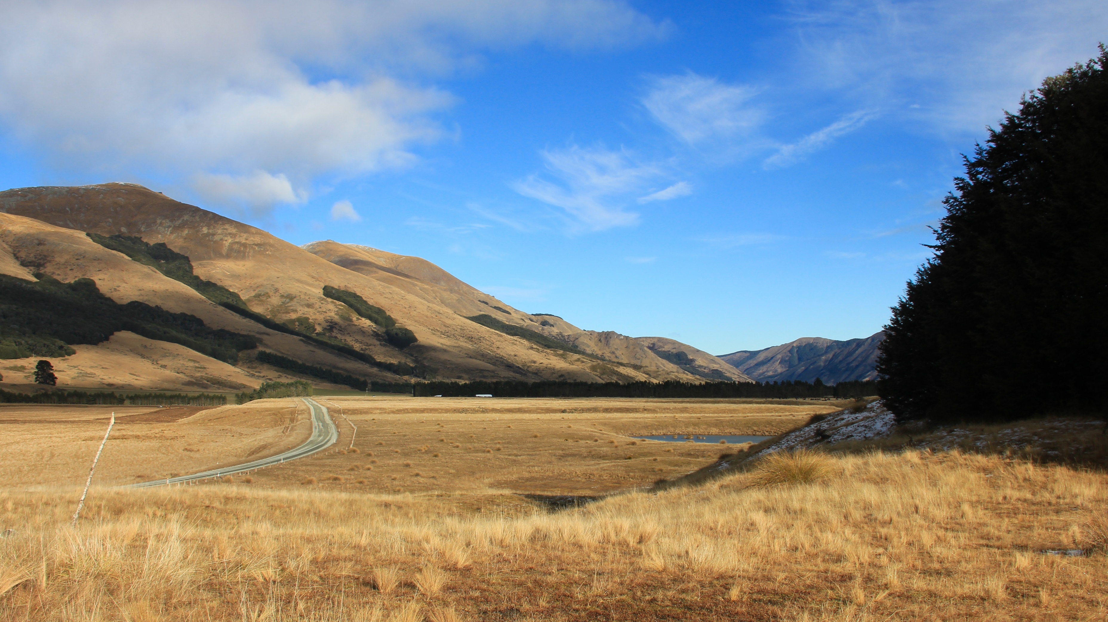
Fangorn
Follow Aragorn’s footsteps and search for the Hobbits.
Plan your trip to New Zealand – and Middle Earth.

Slide 6
What is Perfect Time? The vision and the idea
“Our vision is to create a web application that will allow you to plan your trip by setting different locations or stages. You will also be able to insert generic data for the whole vacation. After your holiday you can add a blog in the App using the already available data from planning your trip. Afterwards you can publish your trip and share it with your friends. They can use your plan as an outline for their own trip by simply importing your published data.”
Make planning your trip simple, flexible and intuitive
Make sharing your experiences easy
Allow using experience of those who came before you

Slide 7
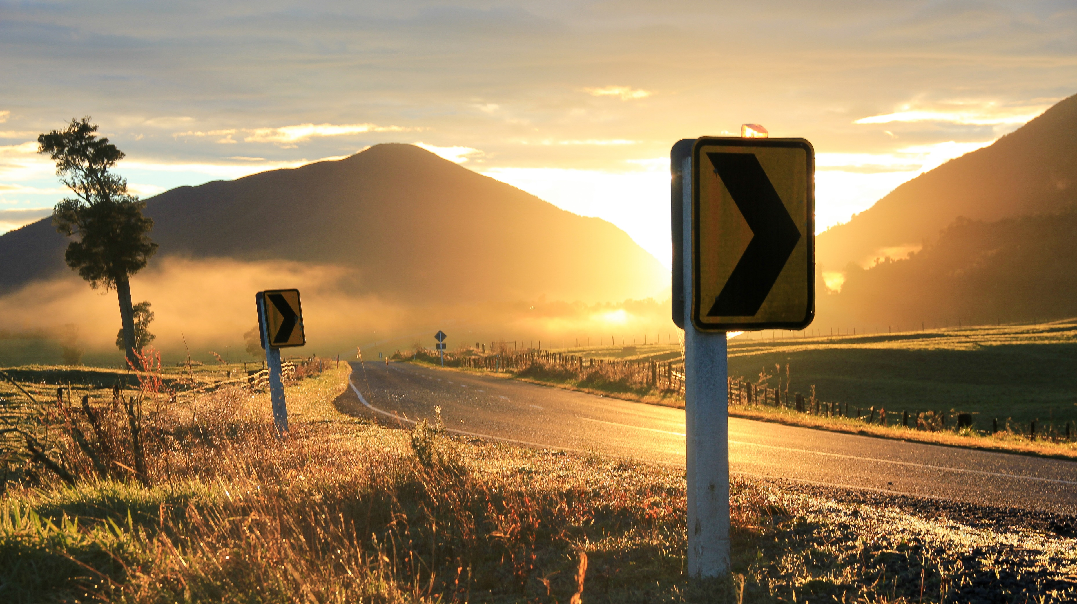
Plan your perfect sunrise.

Slide 8
Why would you use Perfect Time? The customer benefit
UVP, there is no other application with similar functionality
Running as a web application in any browser and on any devise
Customizable by the user
Easy to monetize by advertising activities, location or even whole trips.
Cheap to maintain and easily scalable

Slide 9
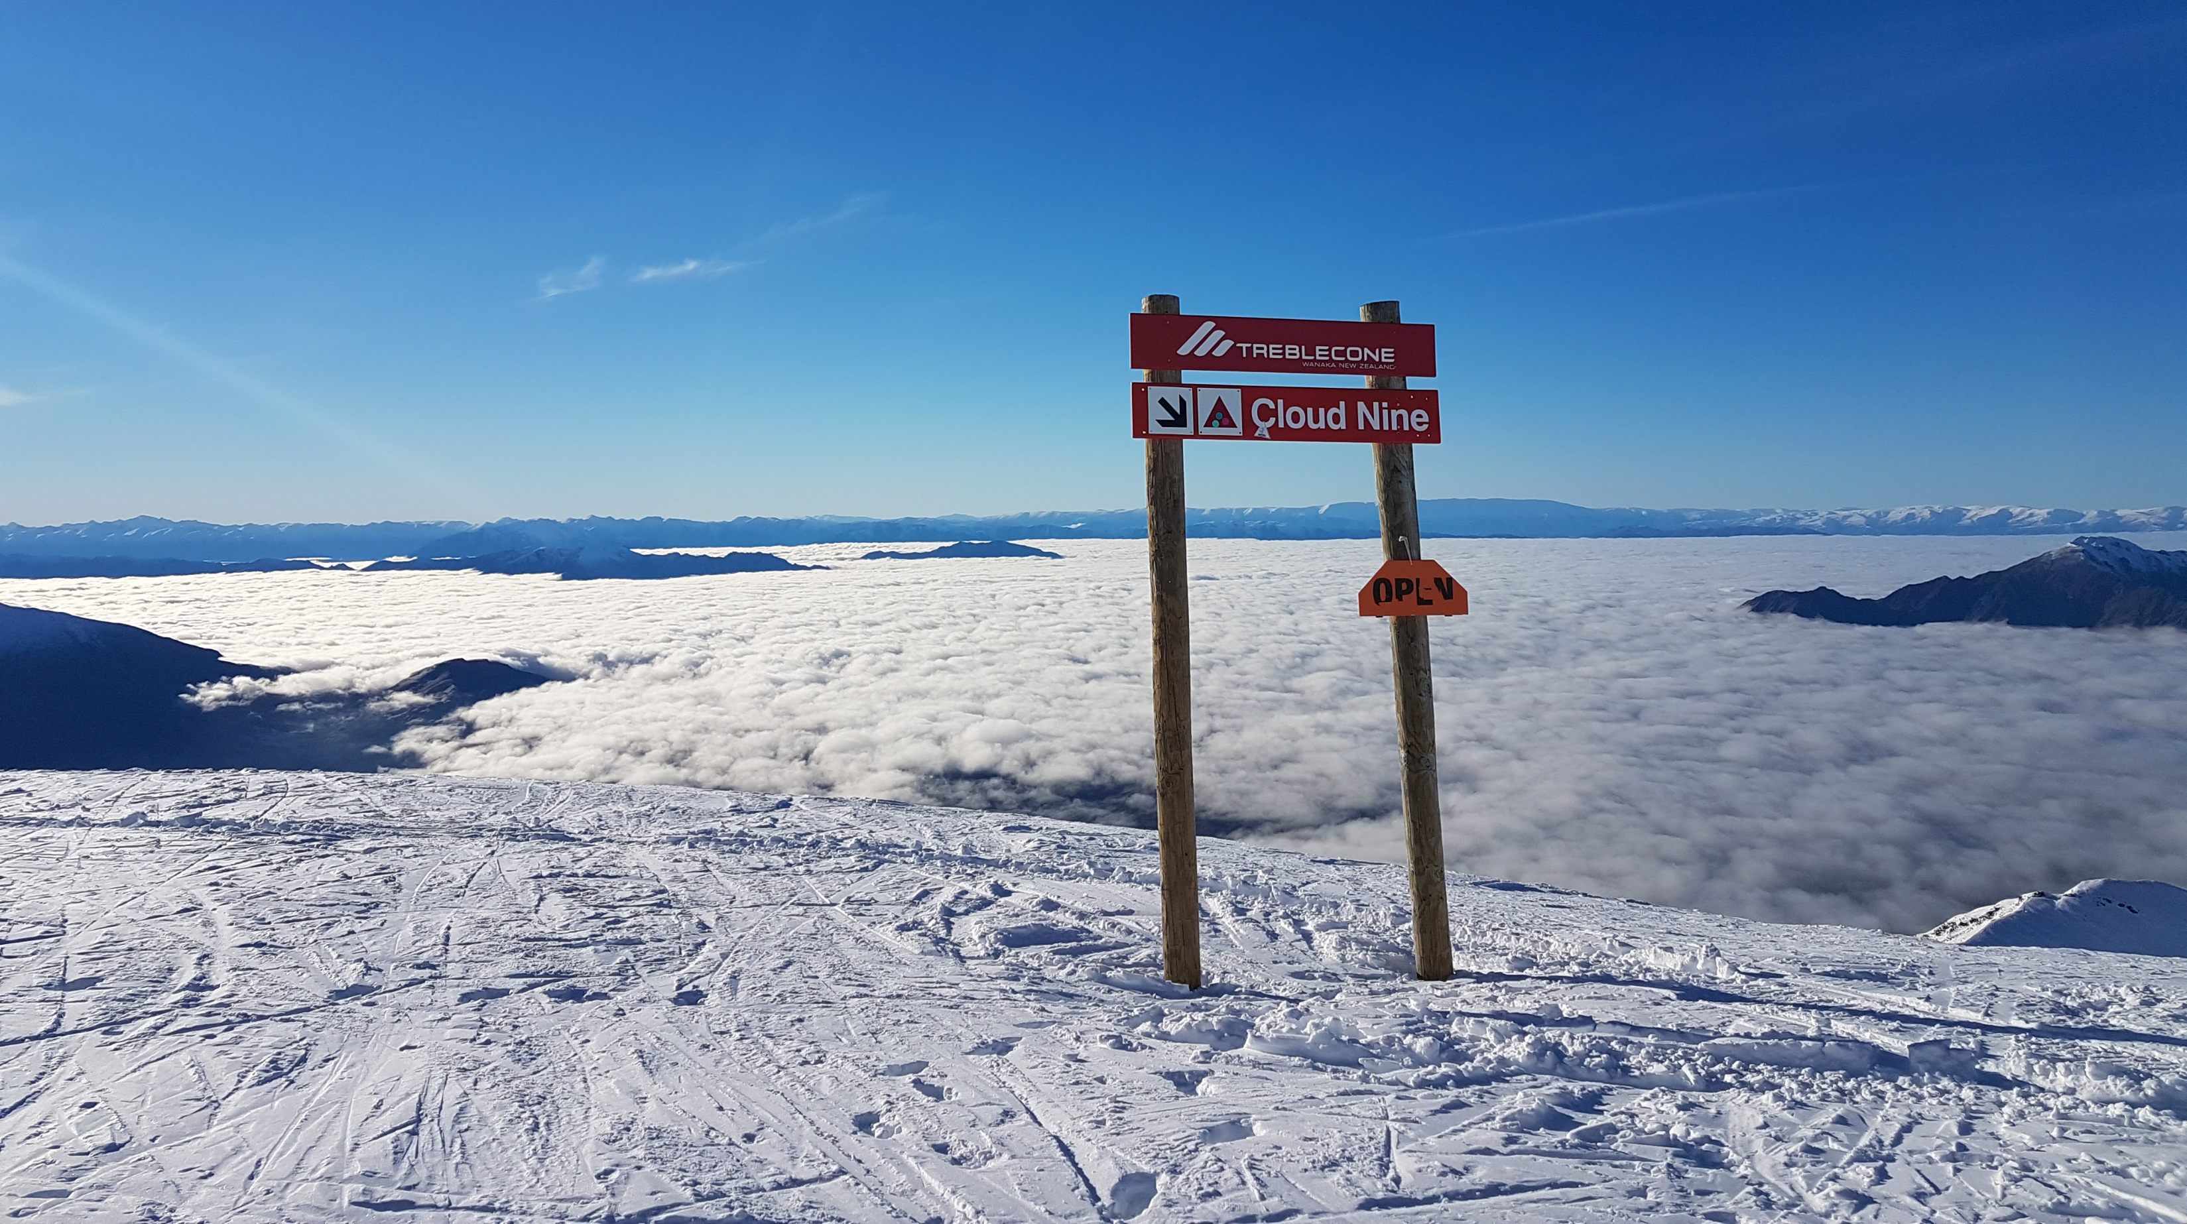
Plan your stay on Cloud Nine.

Slide 10
What is the foundation of Perfect Time? React, Firebase and Redux
React Web Application
Deployed on Google Firebase
NoSQL-database running on Firebase
Components synchronized with Redux

Slide 11
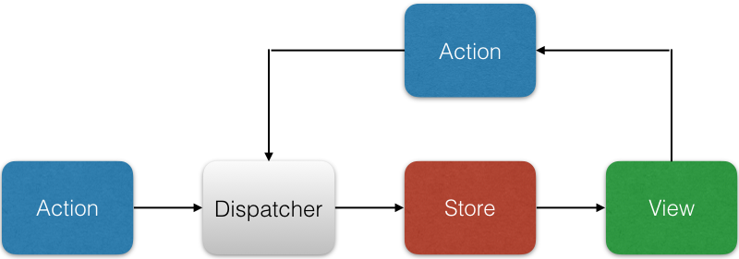
How was Perfect Time designed? Flux architecture

Slide 12
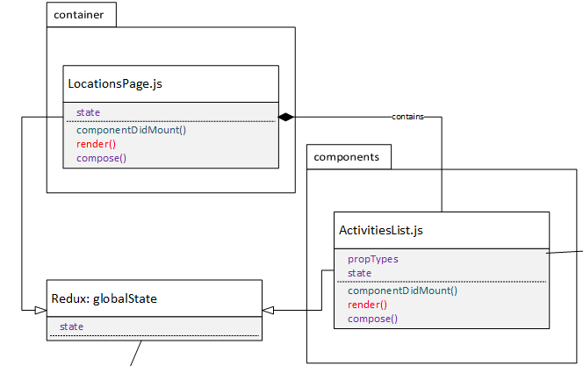
How was Perfect Time designed? Components

Slide 13
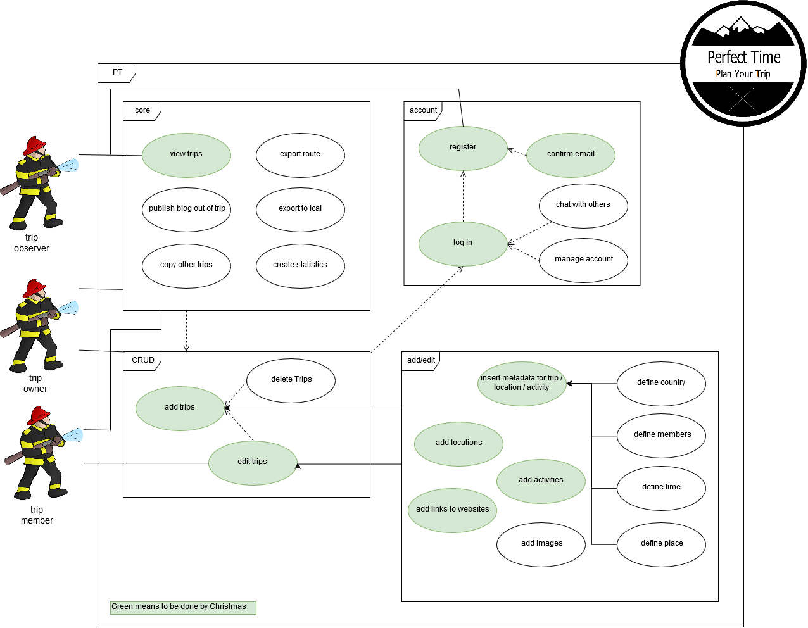
How was Perfect Time designed? Use Cases

Slide 14
How was Perfect Time designed? Use Cases

Slide 15
How was Perfect Time designed? Use Cases

Slide 16
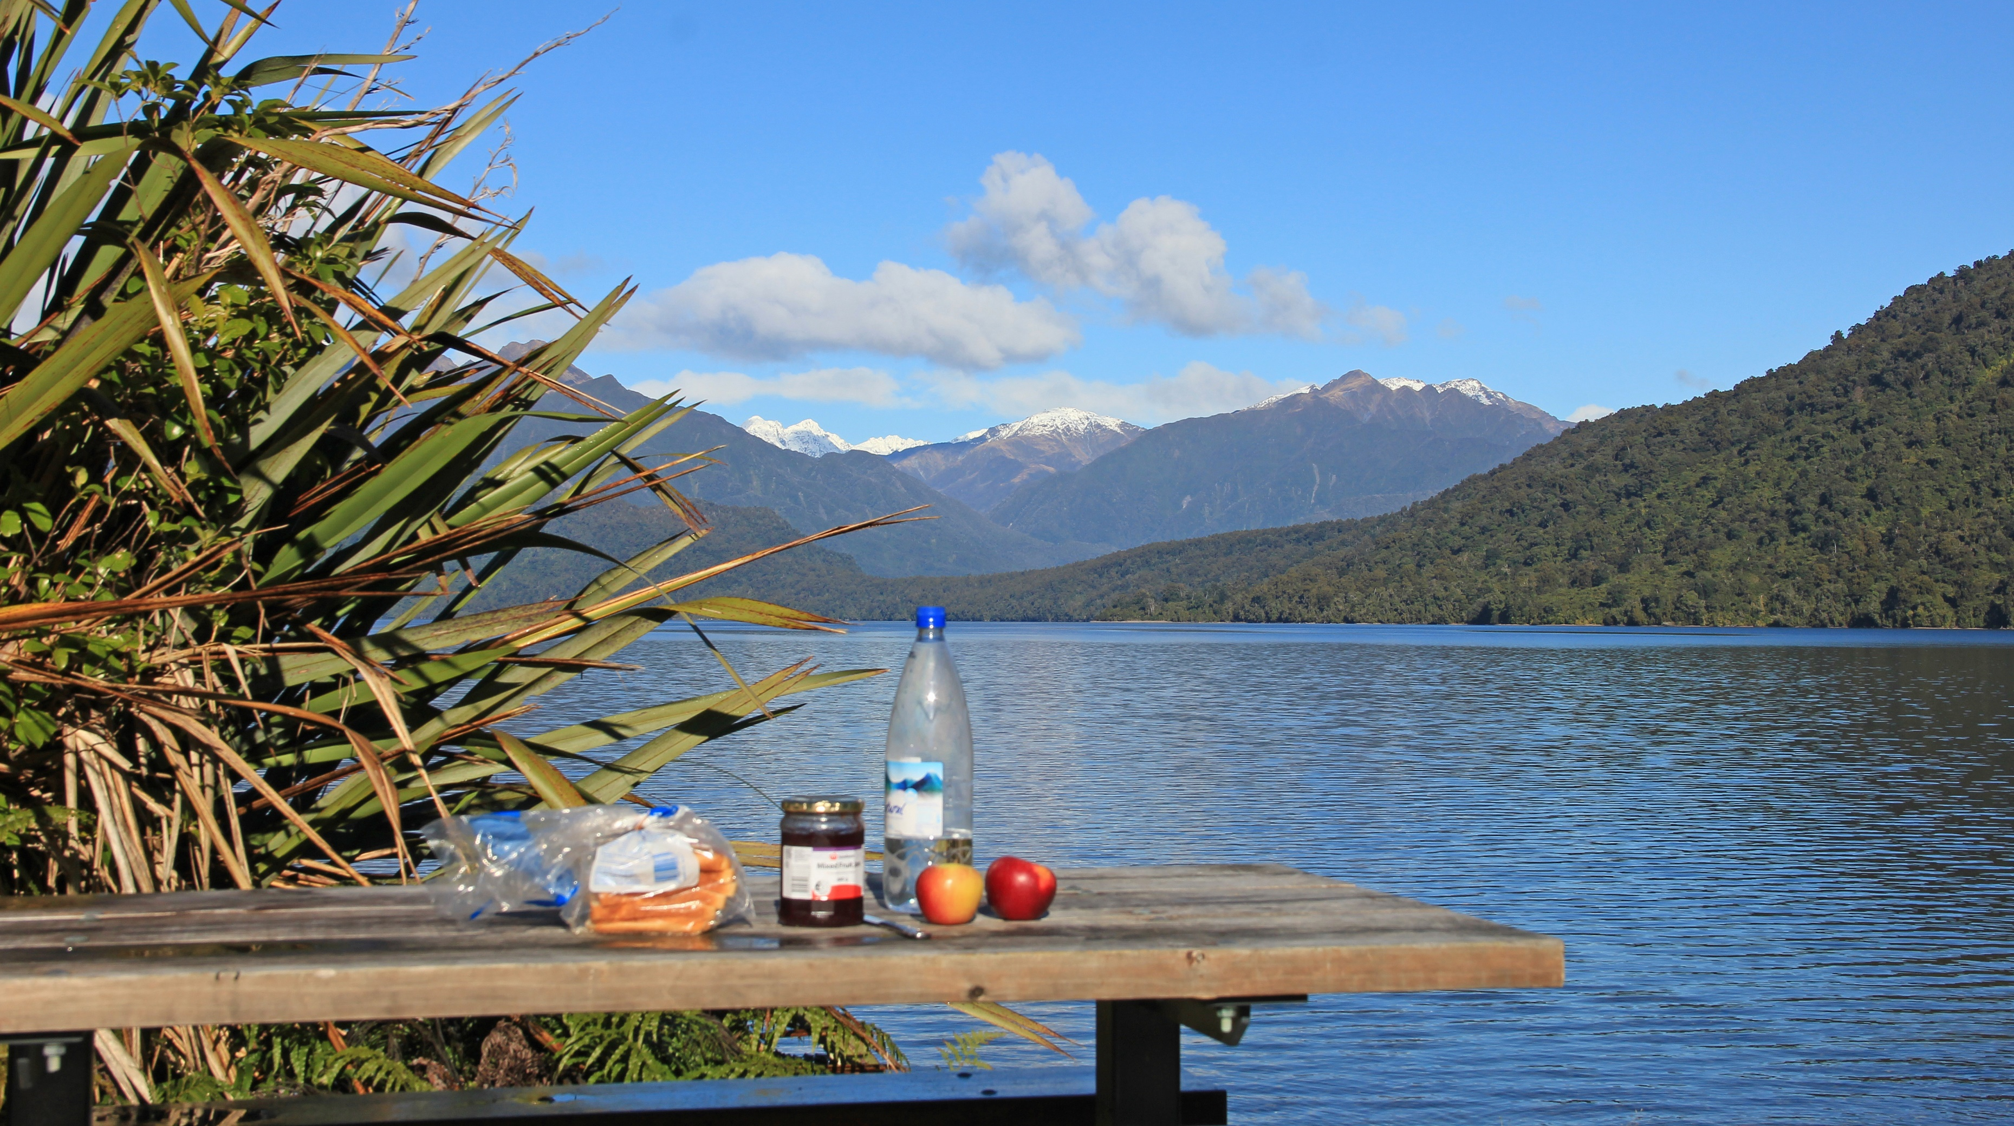
Surprise your loved one with the best date ever.
Plan it now.

Slide 17
Who is creating Perfect Time? The team and the RUP roles
Jan: Systems Analyst, Tester
Lea: Business Process Analyst, Tester, Project Manager
Lukas: Software Architect, Tester, Deployment Manager
Tim: Integrator, Process Engineer

Slide 18
How does the team organize itself? Scrum and YouTrack
The project uses Scrum to plan the workload.
The progress can be accessed through our YouTrack account: https://perfecttime.myjetbrains.com/youtrack/agiles
We publish a weekly blog: https://perfecttime608150251.wordpress.com/

Slide 19
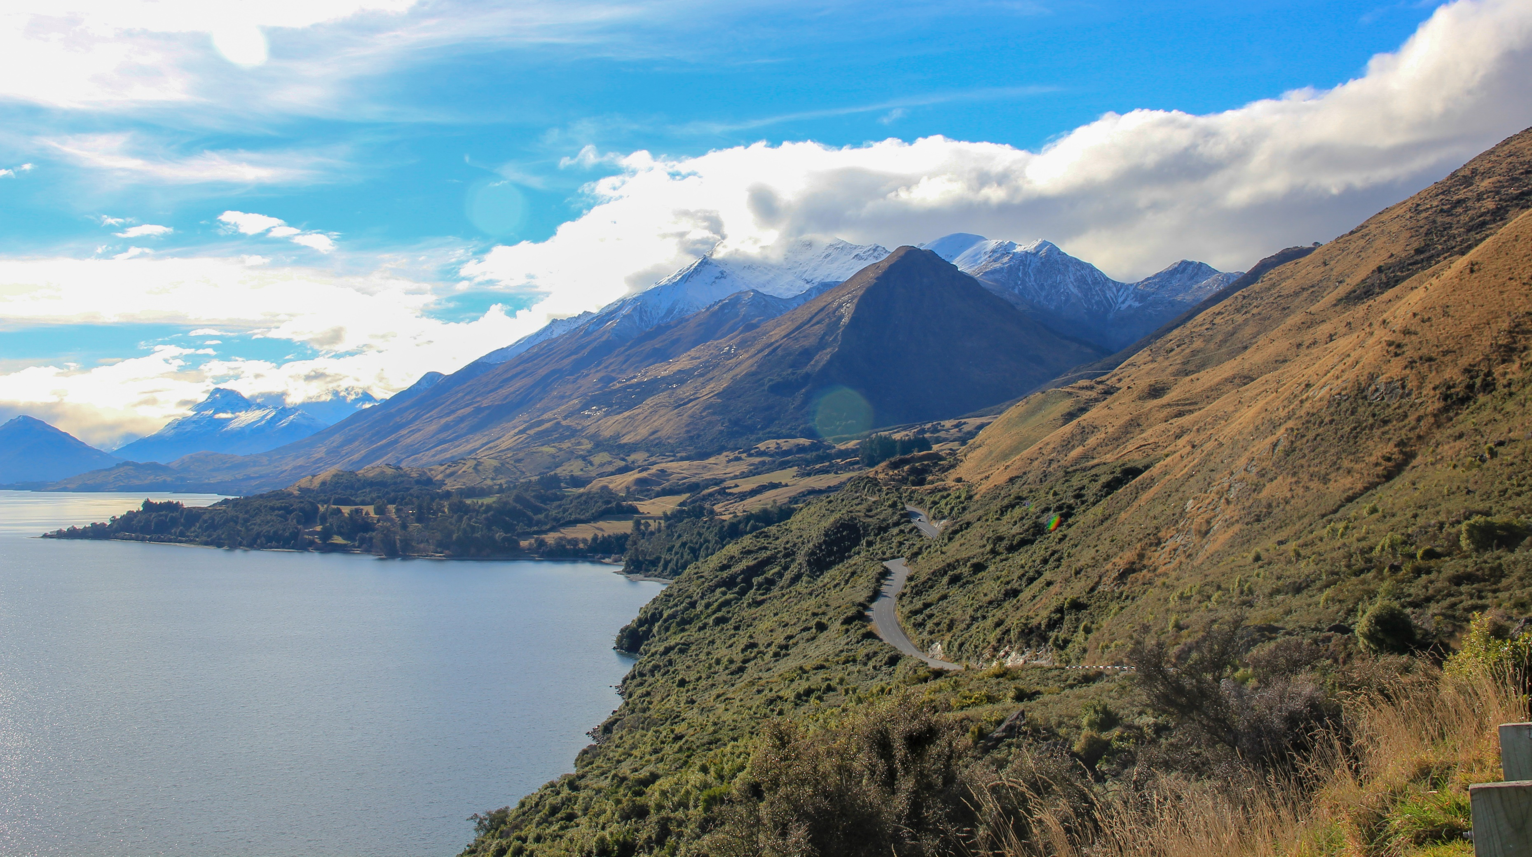
Plan your perfect view.

Slide 20
How is quality promoted and enforced? Merge Requests, Unit testing and Cucumber
Simple Rule: Merge through pull requests and test before you merge.
We create unit tests to test individual components.
We use Cucumber JS and TestCafe to test the whole application.

Slide 21
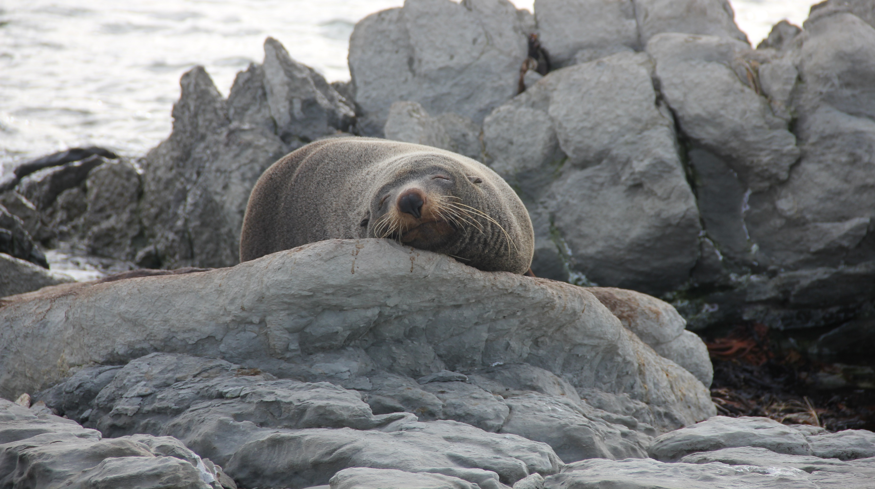
Learn chilling from the pros.
Add the “activity“ today.

Slide 22
What is the current state of the project? Things that are finished
Running application and database integration
View (all) locations
Add, Edit and View Location
Add, Edit and View Activity
Frame

Slide 23
What is the current state of the project? Things that are yet to come
User management
Turn trip into a blog
Upload pictures and videos
Manage trips
Export / Import trip
Export to ical
Security between accounts

Slide 24
What is the current state of the project? Live demonstration

Slide 25
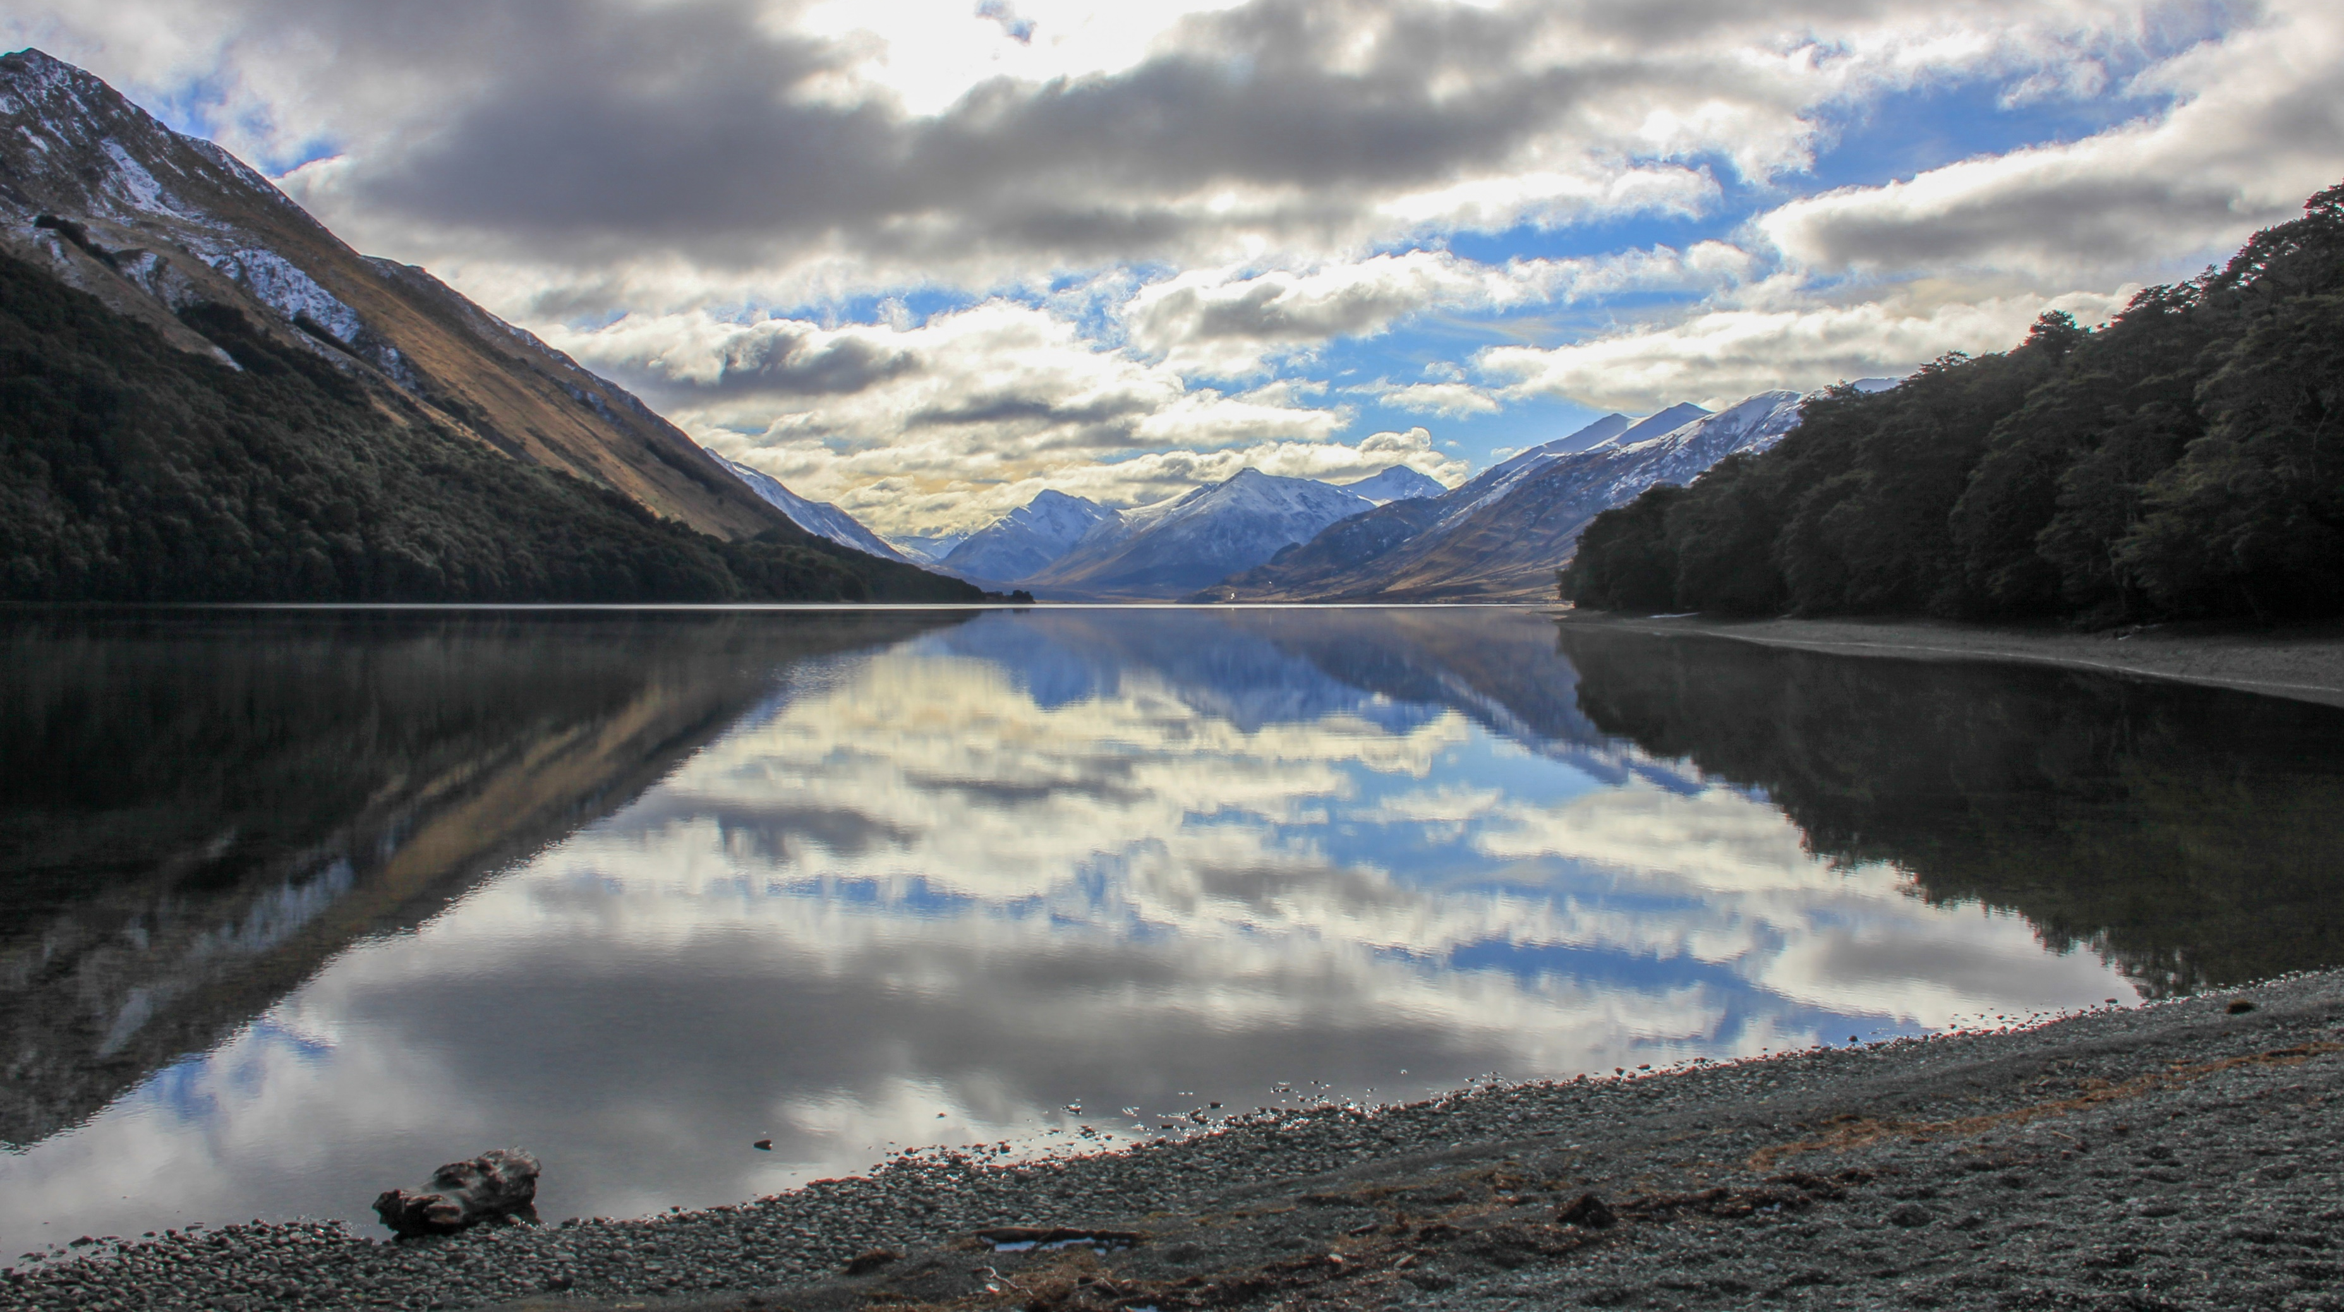
Shoot the perfect picture.
Add the location now.

Slide 26
Thank you for your attention!
And have a Perfect Time.

Slide 27
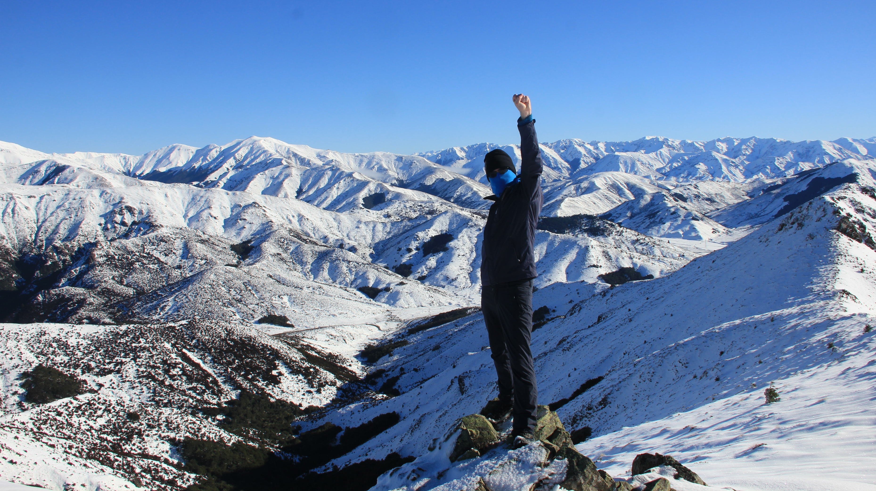
Make every time a Perfect Time.
Plan Your Trip today!

